Slide 1
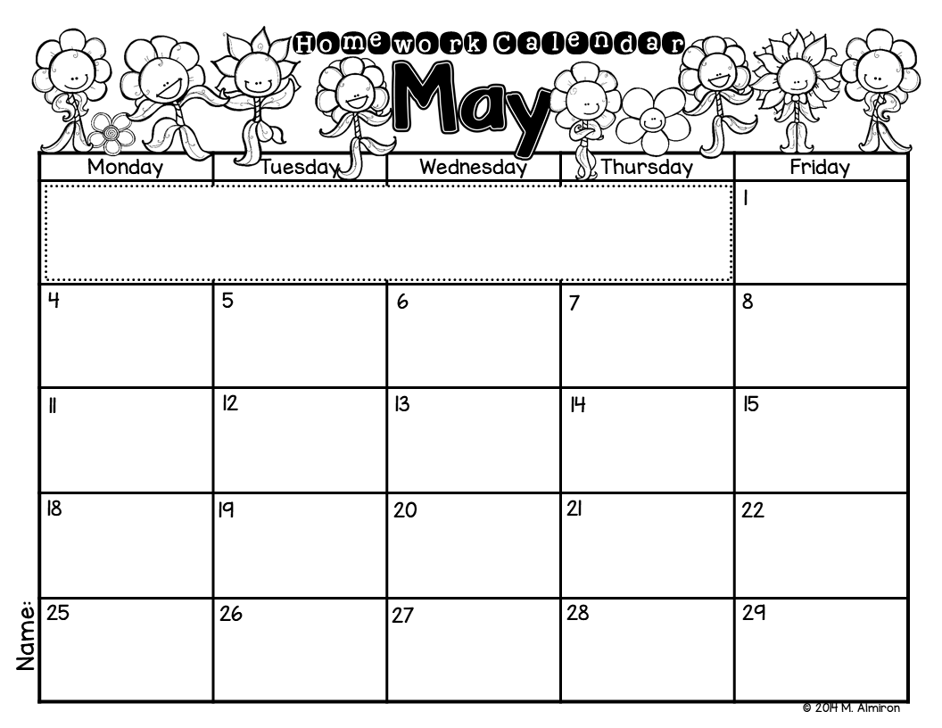
Write to describe a butterfly. Illustrate.
Please color the boxes as you complete each activity.
Don’t forget to read for 20 minutes every night!
Write a letter to your teacher.
Write 3 sentences using sight words.
Write a list with all the insects you know.
Draw your favorite insect. Write to explain why it’s your favorite.
Write a letter to your mom.
What would you like to do if you were a butterfly? Write and illustrate.
Write all the ways you can make 7 (i.e.: 7=3+4)
Write a subtraction sentence
(i.e.: 5 - 2 = 3). Draw objects to represent.
Where would you go if you could fly? Write and illustrate.
Write 3 question sentences.
Write a list of all the things you learned this year in school.
Write all the words you know from the “_ay” family.
Draw and label 5 shapes.
Write a list of animals that live in the ocean.
Draw your favorite ocean creature. Why is it your favorite?
Write a list of summer activities.
What is your favorite thing to do in the summer? Write and illustrate.
Circle all the sight words you can find in a newspaper or magazine.
Write about your favorite book. Why is it your favorite?
Write the steps to make a sand castle. Illustrate.

