Slide 1
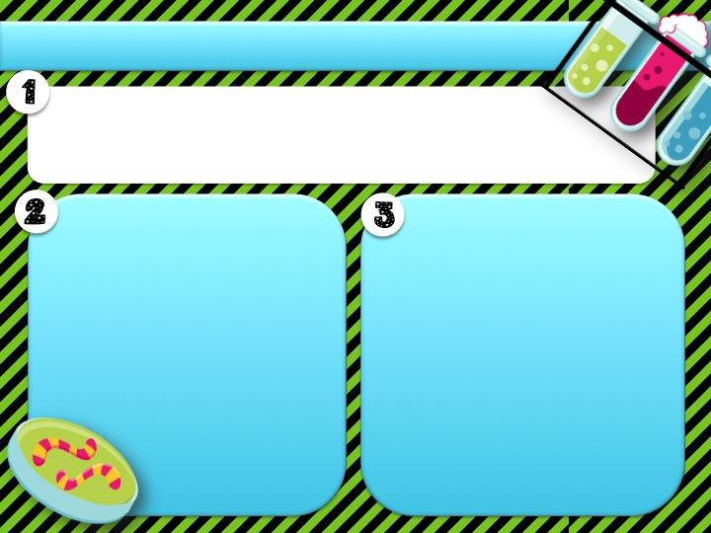
Today is Wednesday, September 18, 2020.
Learning and Language Objective
I will read the black you will read the blue
Learning Objective
Language Objective
I will conduct an investigation that tests the effects of force of friction on an object.
I will explain, in writing, how the force of friction can change an object’s movement.

Slide 2
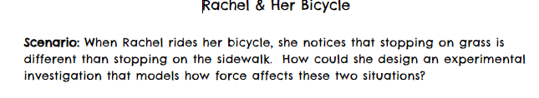
Experimental Design:

Slide 3
How could we test this experiment?
Think: What are some materials that you might have a home that you could use??
Type your answer here

Slide 4
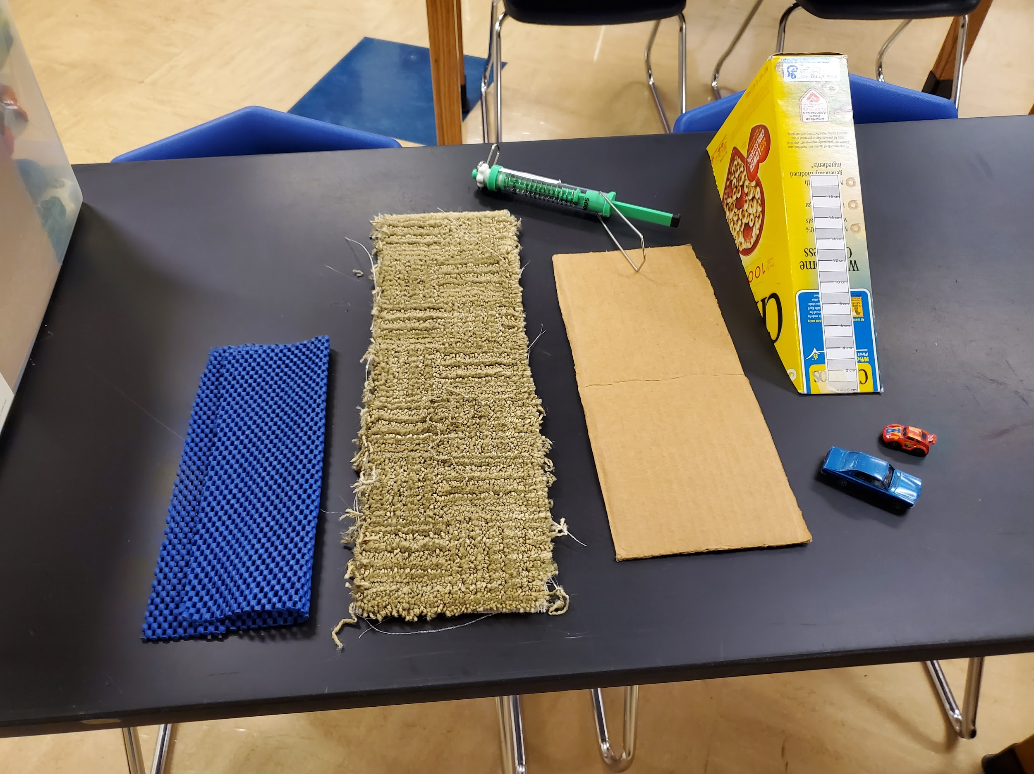
Here is a picture of some of the items brainstormed over the years:
Since we are measuring the force of friction, we need to choose two different surfaces. One surface that is smooth and one that is rough. We want to make sure there is only one variable so we need to be careful when we choose our materials. A few of the materials in this picture are what we call DISTRACTORS. A distractor is something that is not needed and would cause us to have more than 1 variable. What materials do you think we should use?
Type your answer here:

Slide 5
Here’s what I would use: Ramp 1 car Tape measure 2 different surfaces carpet and the cardboard | Distractors: extra car We are not measuring the force of gravity so an extra car would give another variable blue mat I only need 2 surfaces to test; the blue mat would act very similar to the carpet spring scale Once again, I’m not measuring the force of gravity or a push so the spring scale is not necessary

Slide 6
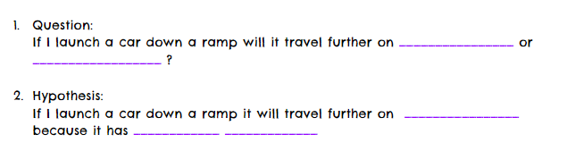
Type here
Type here
Type here
Type here .

Slide 7
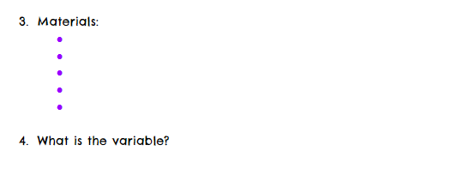
Type here
Type here
Type here
Type here
Type here
Type here
*Remember the variable is the one thing that the scientist is changing/testing

Slide 8
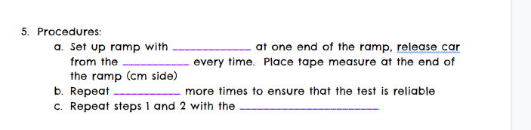
Type here
Type here
Type here
Type here

Slide 9
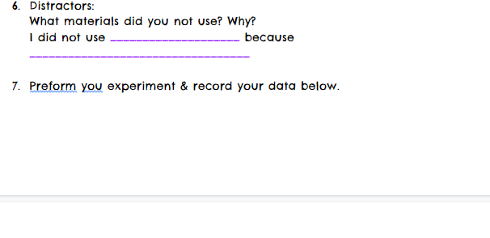
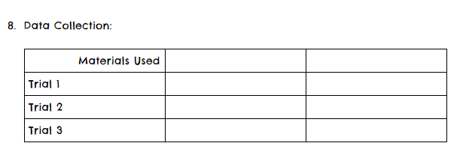
Type here
Type here
If you are unable to perform this experiment; watch my demo video.
Type here
Type here
Type here
Type here
Type here
Type here
Type here
Type here

Slide 10
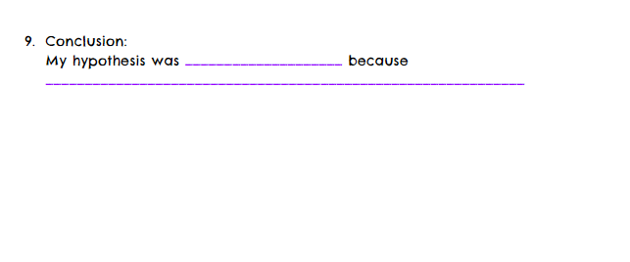
Type here
Type here

